Slide 1
Alkali/Crude Oil Phase Behavior,
IFT, and Soap Partitioning
Presentation for the 18th Rice University Consortium for Processes in Porous Media
Lei Ding
Jose Lopez Salinas
Maura Puerto
Clarence Miller
George Hirasaki
2014-04-21
Notes:
My presentation is…

Slide 2
• Introduction
• Na₂CO₃/Crude Oil Phase Behavior
• IFT Measurement
IFT Measured with Non-equilibrated Samples
IFT Measured with Pre-equilibrated Samples
• Soap Number Measurement and Soap Partitioning
• Conclusion
Contents

Slide 3
Introduction
Alkaline Flooding EOR Process
Types of Alkalis:
Na₂CO_{3,} NaOH, Na₂SiO₄, Na₃PO₄, NH₄OH, and organic alkalis
Oil Description
TAN: 0.88 mgKOH/g (Spiking method)
API Gravity (70°F): 27.5°API (0.89 g/cm³)
Notes:
Promising method for low cost and potential to recover oil. Alkaline: Reduce surfactant adsorption, Soap generation, injection AMINE; Viscosity (70°F): 23.9 cP
Carbonate: reduce ion exchange, mineral dissolution and sequester divalent ions;
NH4OH also promising, but in this study, sodium carbonate

Slide 4
• Introduction
• Na₂CO₃/Crude Oil Phase Behavior
• IFT Measurement
IFT Measured with Non-equilibrated Samples
IFT Measured with Pre-equilibrated Samples
• Soap Number Measurement and Soap Partitioning
• Conclusion
Contents
Notes:
Isomerically pure, isomerized; Single surfactant system; how about soap? WOR? Temperature? WOR=1,3,5,9,24, RT, HT, will not show all

Slide 5
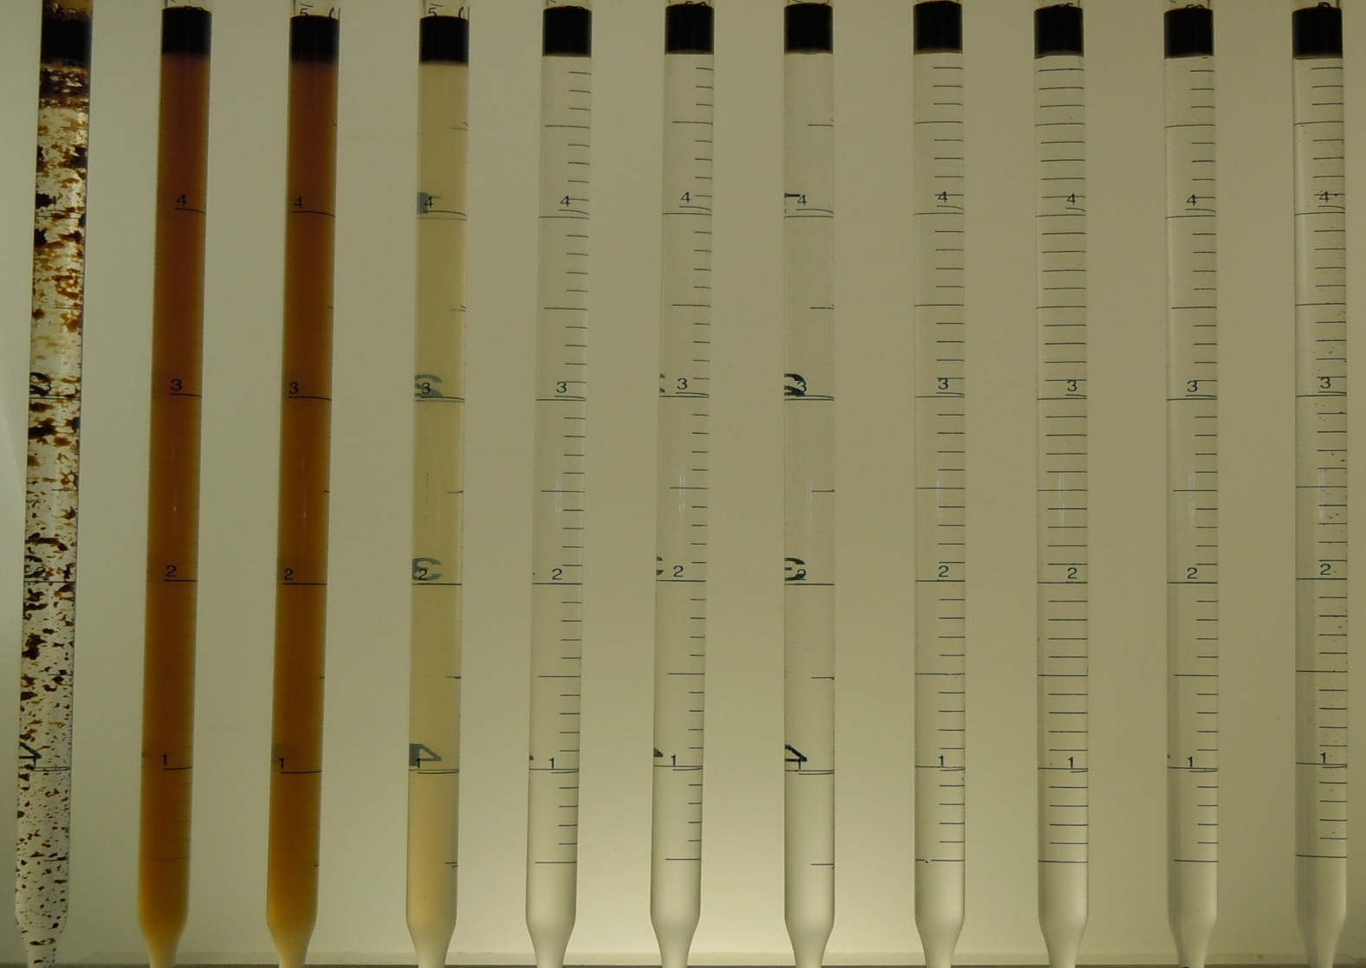
Phase Behavior at WOR=24
After equilibrated for 30 days--at room temperature-77°F (25°C)
% Na₂CO₃ [Surfactant-Free Samples]
0 0.5 1.0 1.5 2.0 2.5 3.0 3.5 4.0 4.5 5.0
Notes:
WOR does not have much influence on optimal salinity
OPTIMAL: lowest free energy at interface, zero spontaneous curvature, bicontinuous microemulsion, equal attraction, highest surfactant density at interface
Test tubes, 60 days, WOR=1, RT; Later IFT using test tubes,

Slide 6
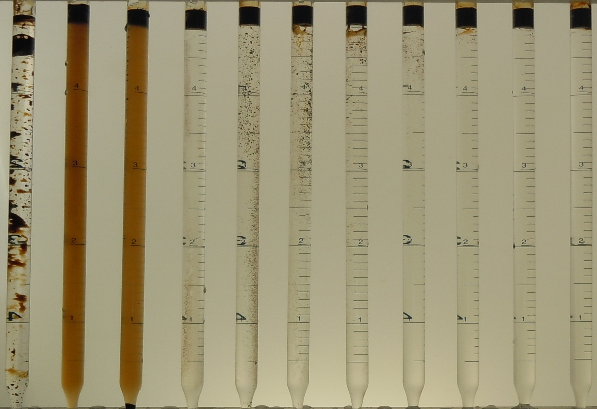
Phase Behavior at WOR=24
After equilibrated for 30 days-at 130°F (54°C)
% Na₂CO₃ [Surfactant-Free Samples]
0 0.5 1.0 1.5 2.0 2.5 3.0 3.5 4.0 4.5 5.0
Notes:
Optimal salinity depends on Temperature
Later IFT using test tubes, WILL not show all results, independent of WOR

Slide 7
• Introduction
• Na₂CO₃/Crude Oil Phase Behavior
• IFT Measurement
IFT Measured with Non-equilibrated Samples
IFT Measured with Pre-equilibrated Samples
• Soap Number Measurement and Soap Partitioning
• Conclusion
Contents
Notes:
Prove hypothesis, Nonequilibrium IFT, dynamic minimum IFT plays an important role in enhanced oil recovery; others believe that Equilibrium IFT (time scale)
Spinning drop method; NON-EQUILIBRATED & PRE-EUILIBRATED

Slide 8
IFT as a function of Salinity and Temperature
(Non-Equilibrated Samples)
Fresh oil and newly prepared alkaline solution are used directly to measure the IFT.
IFT values shown are nearly constant values after transient.
Notes:
Non-equilibrium IFT measurement, in which oil was injected directly into the capillary tube filled with fresh solutions. IFT values are measured after reaching steady state, keep constant for at least 30 min; Almost for all concentrations, a transient minimum IFT can be reached within the first 4 minutes, soap is generated at the oil water interface due to the reaction of alkali and naphthenic acid in the oil drop., existence of a transient minimum IFT criterion for surfactant formulation, not correct at least for this oil, not applicable for this oil

Slide 9
IFT as a Function of Salinity and WORs
(Pre-Equilibrated Samples)
Room Temperature
IFT values were measured at room temperature after becoming constant using equilibrated samples
Notes:
Mixed and reached equilibrium before measurement; optimal salinity independent of WOR; Minimum IFT dependence on WOR, soap concentration, show later. Lowest IFT; IFT value, WOR=50 similar to that in non-equilibrium, WOR=50, show you later because soap concentration,

Slide 10
IFT as a Function of Salinity and WORs
(Pre-equilibrated Samples)
High Temperature, 130 F
IFT values were measured at high temperature after becoming constant using equilibrated samples
Notes:
Optimal salinity independent of WOR, minimum IFT depend on the WOR; soap concentration, show later; Optimal Salinity changes as temperature changes; Lowest IFT; IFT value., WOR=50, show you later because soap concentration,
Not transient but Equilibrium IFT that generate large capillary number

Slide 11
• Introduction
• Na₂CO₃/Crude Oil Phase Behavior
• IFT Measurement
IFT Measured with Non-equilibrated Samples
IFT Measured with Pre-equilibrated Samples
• Soap Number Measurement and Soap Partitioning
• Conclusion
Contents
Notes:
Phosphate buffer, diphosphate and tripolyphosphate

Slide 12
Soap Number Measurement
Procedure
• Soap Extracted by Na₂CO₃ Solution
WOR=3; WOR=5; WOR=9; WOR=24;
• Na₂CO₃ solutions at different concentrations in 20 ml Test Tubes with oil
• Rotate, allow to equilibrate, then separate the aqueous phase
• Soap Extracted by Na₂CO₃ and IPA
WOR=3; WOR=5; WOR=24;
• Na₂CO₃ solutions at different concentrations in 30 ml vials;
• Rotated and equilibrated as above, add equal volume (as brine) of IPA;
• Rotate, allow to equilibrate, then separate the aqueous phase
High-pH two-phase titration for soap in aq. phase
- BG as indicator, TEGO as titrant, High pH buffer, Chloroform;
Notes:
Total acid number determined by non-aqueous phase titration could not distinguish the acids that can generate natural soap and those that can consume alkali without producing surfactant. Soap, sodium naphthenate, anionic surfactant. Soap can determined by High pH two phase titration;
TEGO cationic surfactants, form ion pairs; soap only active in neutral and alkaline solution

Slide 13
Water Soluble Soap Extracted by Na₂CO₃ (bars)
Soap Extracted by Na₂CO₃/IPA (lines)
Note that total acid number = 0.88 mg KOH/g
Notes:
Coincide with the color changing; room temperature; extractable soap; TAN; why soap decrease? Too hydrophilic soap independent of WOR and salinity; difference = hydrophobic soap, carboxylate in resin and asphaltene; difference = phenolic and porphyrin; difference = short chain length surfactant/too hydrophilic; as a function of WOR-INCREASE; many ways to calculate the S.P. , this is a really complicated system, different components of soaps with different carbon chain length and thus, different interfacial property and different S.P.

Slide 14
Water Soluble Active Soap (WSAS) in Aqueous Phase as a Function of Salinity and WOR
WSAS is that which can partition between oil and aqueous phases, i.e., the difference between water-soluble soap at low and high
Notes:
Water soluble active soap in aqueous phase, overall water soluble active soap; different soap with different partition parameter and HLB
Soap distribution or partition and extraction are based on concentration. Difference between WOR

Slide 15
Partition Coefficient of WSAS and IFT
WOR=3
K=1
IFTs are measured at room temperature, WOR=3
Notes:
Blue line, red line
Room temperature; various ways to define, 0; infinity

Slide 16
Partition Coefficient of WSAS and IFT
WOR=9
K=1
IFTs are measured at room temperature, WOR=9
Notes:
Blue line, red line
Room temperature;0; infinity; many ways to calculate the S.P., here I only show this way. Other ways are still in the same magnitude.

Slide 17
WSAS Concentration in Aqueous/Oil Phase as Function of WOR at Optimal Na₂CO₃ Conc., 1.4 wt% at 77°F
Notes:
Water soluble active soap concentration in aqueous phase; extrapolation; extrapolation

Slide 18
• Introduction
• Na₂CO₃/Crude Oil Phase Behavior
• IFT Measurement
IFT Measured with Non-equilibrated Samples
IFT Measured with Pre-equilibrated Samples
• Soap Number Measurement and Soap Partitioning
• Conclusion
Contents

Slide 19
Conclusions
Equilibrium IFT (IFT measured with pre-equilibrated samples) depends on Na₂CO₃ concentration, WOR, and temperature. For WOR between 1 and 50 the lowest IFTs occur near 1.4% Na₂CO₃ at 77°F and near 1.0% Na₂CO₃ at 130°F.
At 77°F the water soluble active soap (WSAS) partitioning coefficient is close to unity at 1.4% Na₂CO₃ for all WOR. However, IFT is lowest when WSAS concentration (at 1.4% Na₂CO₃) in both aqueous phase and oil phase is greatest, i.e., at WOR=1.
The lowest IFT measured was 0.001 mN/m for WOR=1 at 130°F, but the ultralow equilibrium IFT region is small.

Slide 20
Acknowledgement
This work was financially supported by Rice University's Consortium for Processes in Porous Media
Thank you!
Questions?

Slide 21
Backup

Slide 22
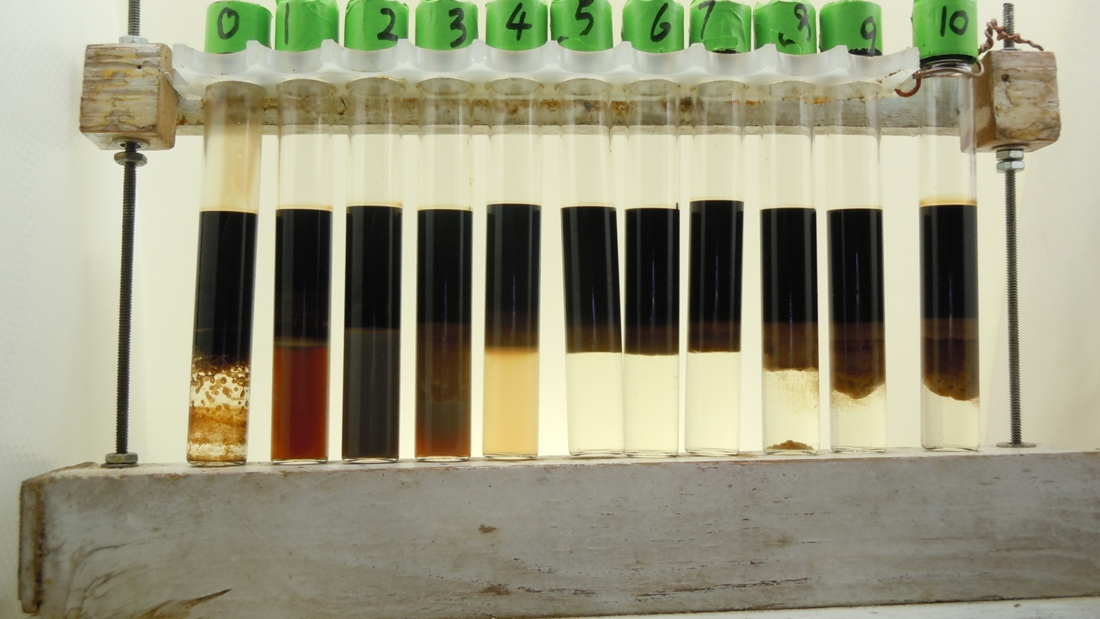
Phase Behavior at WOR=1
After equilibrated for 60 days-at room temperature-77°F (25°C)
% Na₂CO₃ [Surfactant-Free Samples]
0 0.5 1.0 1.5 2.0 2.5 3.0 3.5 4.0 4.5 5.0
After equilibrated for 60 days using test tubes, emulsions is much less.
Notes:
Non-classical phase behavior; highest Winsor 1 salinity and lowest Winsor 11 salinity, volume greater than initial volume; gradually partitioning of soap into oil phase, at first, color of aqueous phase, more oil solubilized, Vo/Vs (opposite effect, by increasing salinity, Vs decrease,)

Slide 23
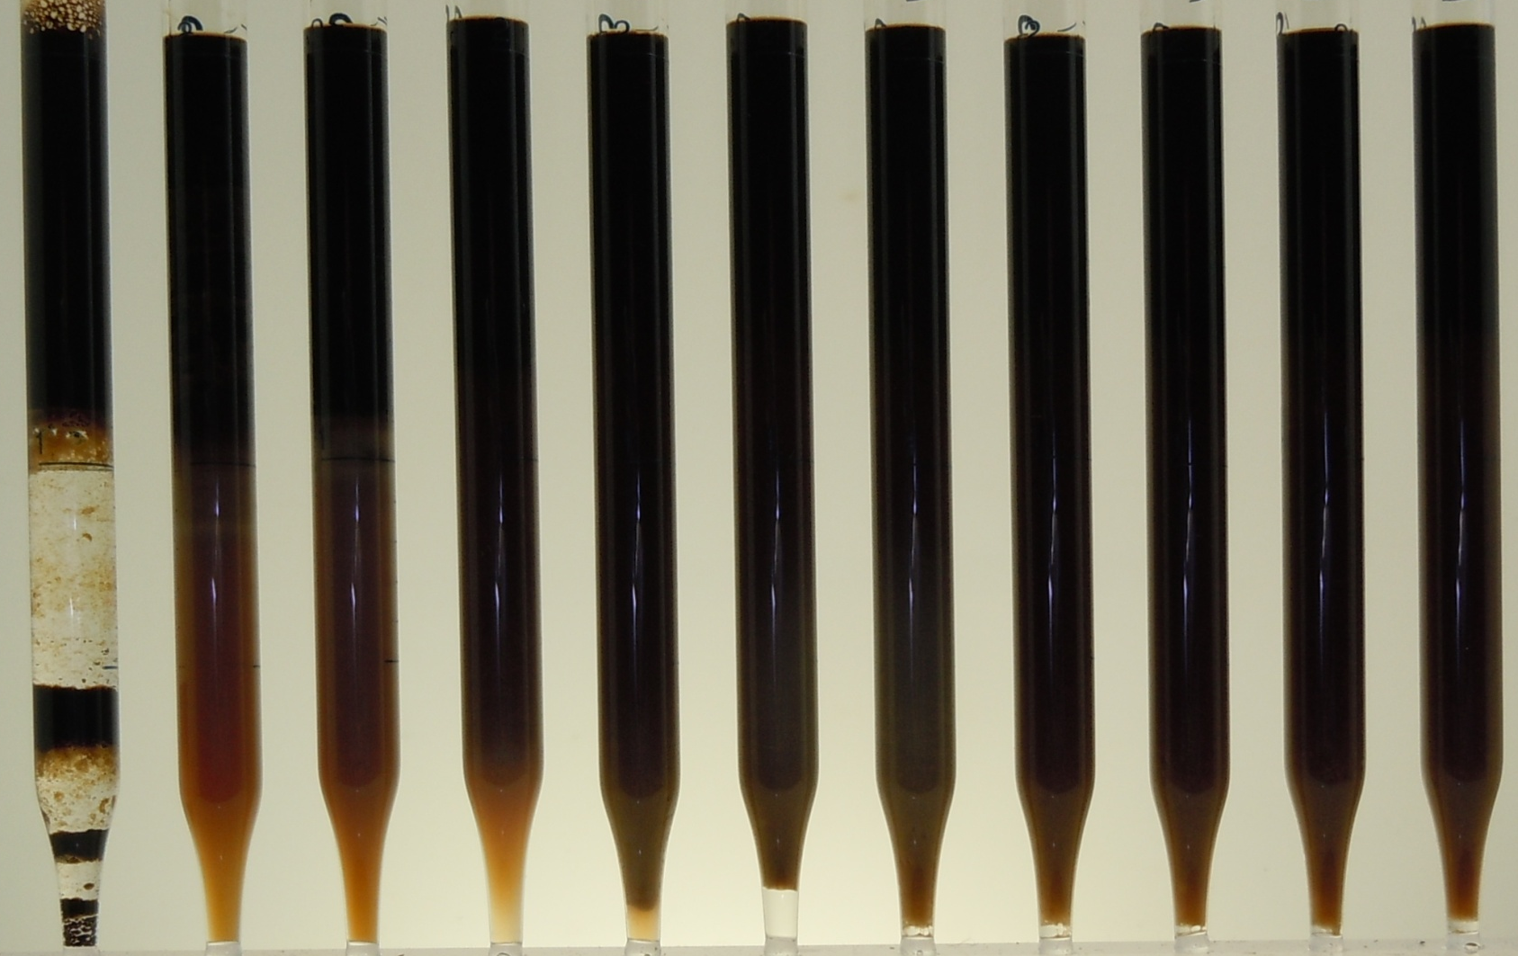
Phase Behavior at WOR=1
After equilibrated for 30 days-at room temperature-77°F (25°C)
% Na₂CO₃ [Surfactant-Free Samples]
0 0.5 1.0 1.5 2.0 2.5 3.0 3.5 4.0 4.5 5.0
Notes:
Presented last year’s meeting, at that time, prepare phase behavior samples, using, salinity scan, difficult, inversion salinity, abnormally high, soap is more lipophilic, Emulsions may be misleading or difficult to judge, emulsion
Emulsification &IFT; Stability of emulsion, coalesce, film of the water oil interface, asphaltene surfactants adsorbed, stable much longer time to equilibrate

Slide 24
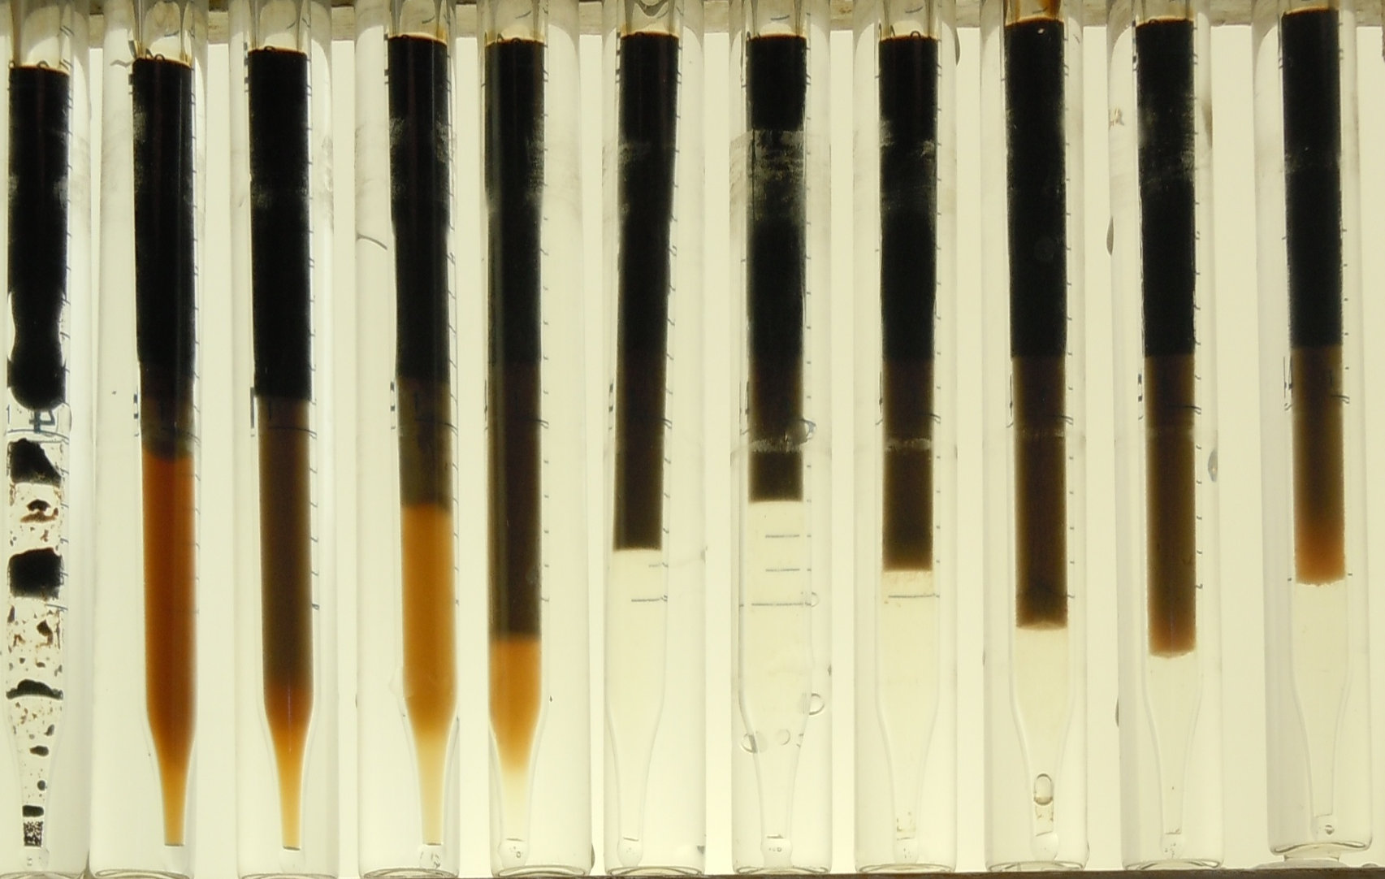
Phase Behavior at WOR=1
After equilibrated for 30 days-at 130°F (54°C)
% Na₂CO₃ [Surfactant-Free Samples]
0 0.5 1.0 1.5 2.0 2.5 3.0 3.5 4.0 4.5 5.0
Notes:
Later IFT using test tubes, WILL not show all results, independent of WOR

Slide 25
Dynamic IFT behavior of Non-Equilibrated Samples
IFTs are measured at 25 °C and 54°C respectively
Fresh oil and new prepared alkaline solution are used directly to measure the IFT

Slide 26
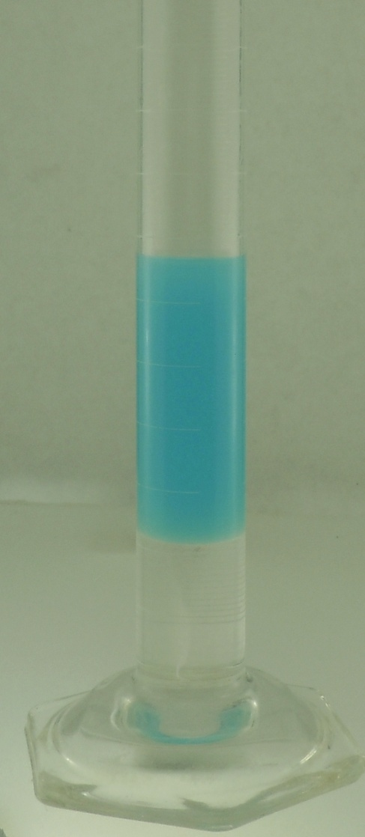
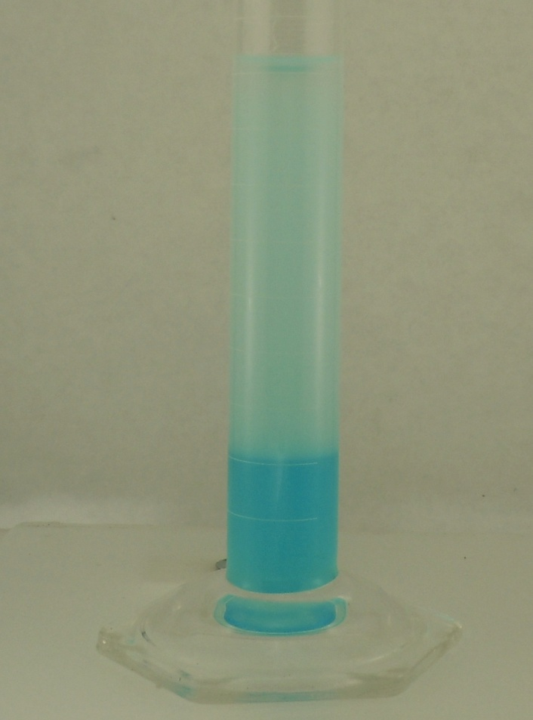
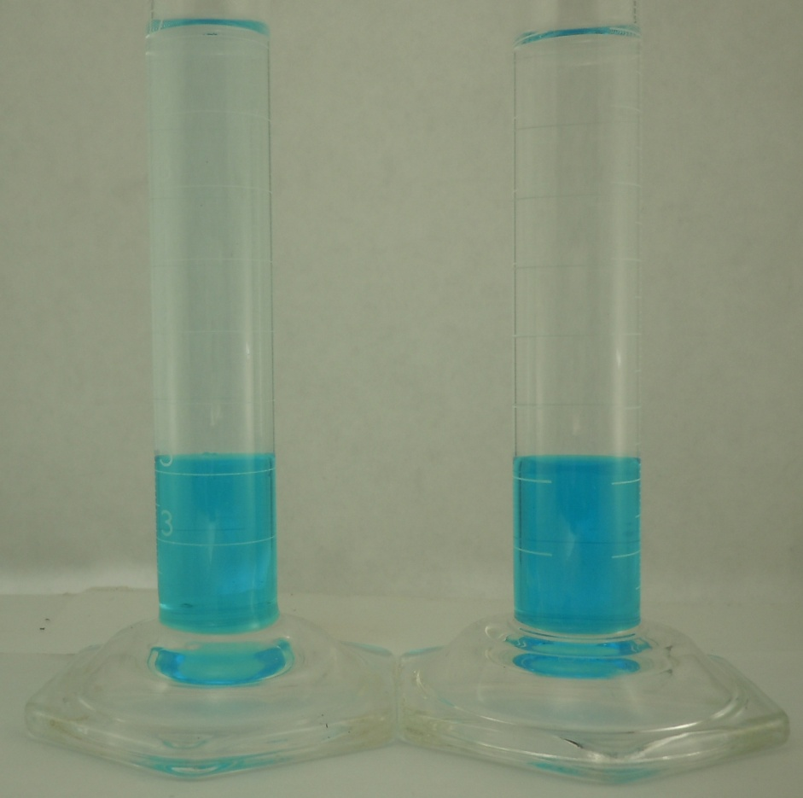
High pH Two Phase Titration
percentage of completion using the TEGO volume added. [TEGO]=0.002 M
0 % 92.5% 99% 100%
Initial stage
92.5% of the titrant needed for the
end point
Drop before
end point
End point
José Luis López-Salinas, Ph.D. Dissertation, 2012
Notes:
MBCl; TEGOCl; BGNa;SDSNa

Slide 27
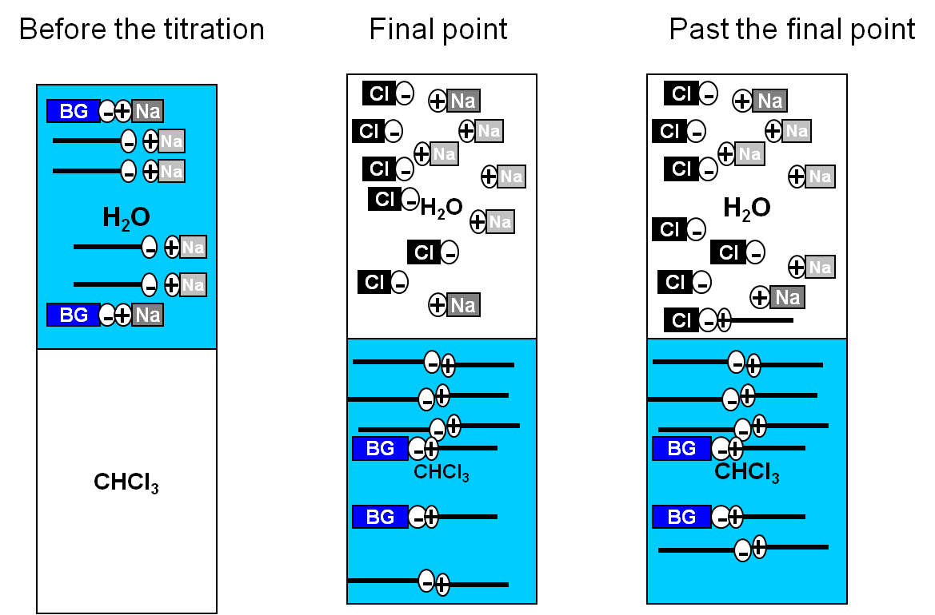
High pH Two Phase Titration
José Luis López-Salinas, Presentation
Notes:
Potentionmetric: solubility; C<12; high salinity; sensitive to surfactant and salts;
Colometric: additional components does not have appreciable effects; C<12 not stoichiometry, (different dissociation constant)

Slide 28
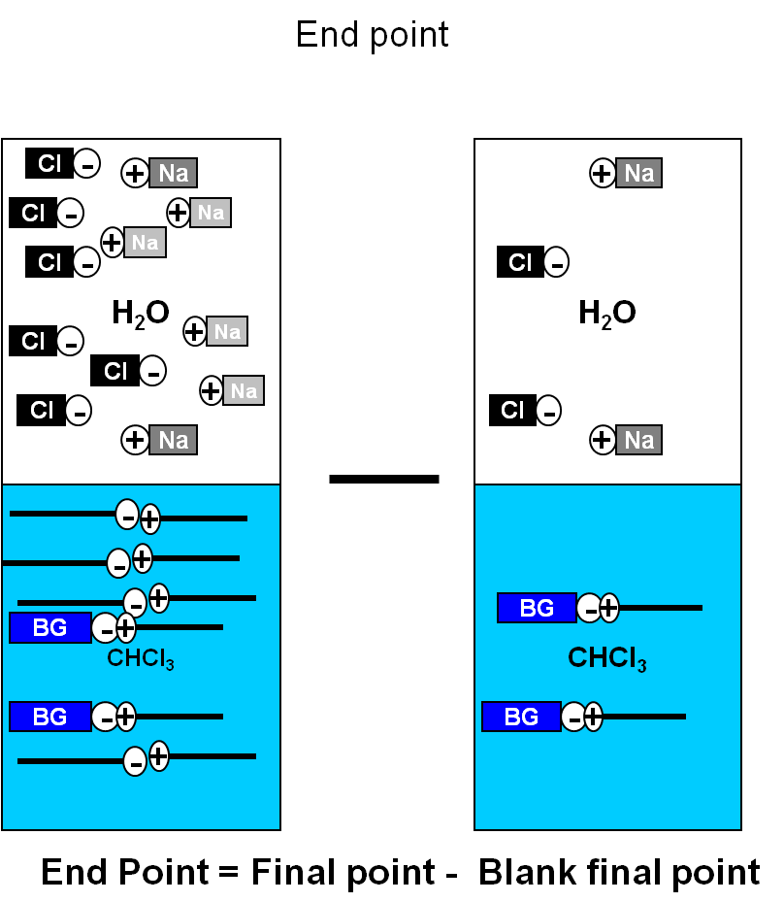
High pH Two Phase Titration
José Luis López-Salinas, Presentation
Notes:
Salinity has little effect of the blank for the salinity range studied

Slide 29
Sodium Carbonate Consumption by Crushed Berea Sandstone Core as a Function of Concentration
Notes:
Ion minerals

Slide 30
Equilibrium IFT as a Function of Salinity and Time
IFT as a function of salinity and aging time at 25°C using equilibrated samples
Under Optimum Region
Over Optimum Region
Optimum Region
Samples with a WOR=3 has been equilibrated in test tubes for more than 20 days, see next slide, WOR=3
Notes:
Basically, three catogories,

Slide 31
IFT measurement as a Function of Salinity and Time
IFT as a function of salinity and aging time at 54°C using equilibrated samples
Under Optimum Region
Over Optimum Region
Optimum Region
Samples with a WOR=3 has been equilibrated in test tubes for more than 20 days, see next slide. After calculation of density WOR=3

Slide 32
Comparison of Equilibrium IFT Between With and Without Darker Substance
Samples were equilibrated at room temperature for more than 20 days
Notes:
Too much; obscure; Winsor type 3, include; Winsor type 1, appeared to be a colloidal dispersion; oil and sodium naphthenate rich microemulsion that in equilibrium with the remainder of lower phase microemulsion

Slide 33
Comparison of IFT Using Oil and Emulsion
WOR=5
Samples were mixed and then equilibrated at room temperature for more than 20 days
Excess-oil Density has been measured and it is different from the original oil density
Emulsion Density has also been measured
Notes:
Colloidal dispersion; microemulsion phase with a higher ratio of oil to brine; related to soap amount; emulsion not colloidal dispersion

Slide 34
Equilibrium IFT as a Function of Settling Time
WOR=5
1.4% Na₂CO₃
Samples were mixed and then equilibrated at room temperature for different time
Excess-brine Density has been measured and it is different from the original brine density
Notes:
The longer equilibrium time, the lesser time used to reach equlibrium

Slide 35
Correlation of IFT with soap Partition Coefficient
WOR=5
K=1
IFTs are measured at room temperature, WOR=5

Slide 36
Correlation of IFT with soap Partition Coefficient
WOR=24
K=1
IFTs are measured at room temperature, WOR=24

Slide 37
Correlation of IFT with soap Partition Coefficient
K=1
The amount of active soap is regarded as the soap extracted by IPA

Slide 38
Correlation of IFT with soap Partition Coefficient
K=1
The amount of overall active soap is regarded as the WSAS obtained at WOR=24

Slide 39
TAN, Soap Extracted by IPA, Water Soluble Soap, Water Soluble Active Soap
Soap Extracted by IPA
Water Soluble Soap
Water Soluble Active Soap

Slide 40
Correlation of IFT with Soap Concentration
The amount of active soap is regarded as the difference of water soluble soap between that at low salinity and high salinity

Slide 41
Correlation of IFT with Soap Concentration
The amount of active soap is regarded as the difference of water soluble soap between that at low salinity and high salinity

Slide 42
Inversion Point with N-octane
1% overall surfactant blend (S13D/S2=4:1)
Different Types of Electrolytes
Inversion Molarity and Na Molarity were obtained from phase behavior test while Figures of Na Activity was calculated by Phreeqc Brine Software using pitzer database (for high salinity)

